Slide 1


BINDURA UNIVERSITY OF SCIENCE EDUCATION FACULTY OF SCIENCE
DEPARTMENT OF COMPUTER SCIENCE
STUDENT : FRANK CHINEMBIRI
REGISTRATION No. : B193090B
DEGREE PROGRAMME : COMPUTER SCIENCE
SUPERVISOR : MR MUZURURA
Automated Tomato Plant Leaf Disease Detection: Using Line Follower Robots, Computer Vision and Convolutional Neural Networks in Green Houses

Slide 2
INTRODUCTION
The use of automated plant disease detection has become increasingly important in the agricultural industry. Automated plant disease detection systems can help farmers and other agricultural professionals to identify and diagnose diseases quickly and accurately, allowing them to take action before the disease spreads and causes significant damage. This technology can also help to reduce the amount of time and resources spent on manual inspection, which can be costly and time-consuming. This literature review will explore the potential benefits of automated plant disease detection systems, as well as their limitations. It will also discuss the current state of research in this field, as well as potential future directions for research.

Slide 3
Automated plant disease detection systems have several potential benefits for farmers and other agricultural professionals. First, these systems can help to reduce the amount of time spent on manual inspection, which can be costly and time-consuming (Liu et al., 2019). Automated systems are also able to detect diseases more quickly than manual methods, allowing farmers to take action before the disease spreads (Liu et al., 2019). Additionally, automated systems are able to detect diseases more accurately than manual methods (Liu et al., 2019). This accuracy can lead to better yields by reducing losses due to misdiagnosis or late diagnosis (Liu et al., 2019). Finally, automated systems are able to detect diseases in a variety of environments, including those with limited access or resources (Liu et al., 2019).

Slide 4
STATEMENT OF THE PROBLEM
The increasing prevalence of plant diseases is a major concern for agricultural production. Plant diseases can cause significant losses in crop yields, resulting in economic losses for farmers and other stakeholders. Automated plant disease detection robots can help to reduce these losses by quickly and accurately detecting plant diseases in the field. Such robots can be equipped with sensors that detect changes in the environment, such as temperature, humidity, and light levels, as well as cameras that detect visual signs of disease. By combining these technologies, automated plant disease detection robots can provide early warning of potential problems and enable farmers to take preventive action before the disease spreads further.

Slide 5
RESEARCH OBJECTIVES
1.Develop and implement an automated plant disease detection system using line follower robots and computer vision.
2.Utilize convolutional neural networks to accurately identify plant diseases in greenhouse plants.
3.Evaluate the performance of the system in terms of accuracy and real-time speed.

Slide 6
RESEARCH QUESTIONS
1.How can a line follower robot and computer vision be used to develop an automated plant disease detection system for greenhouse plants?
2.How can convolutional neural networks be utilized to accurately identify plant diseases in greenhouse plants in real-time?
3.What is the accuracy and real-time speed of the automated plant disease detection system, and how does it compare to traditional methods of disease detection?

Slide 7
LITERATURE REVIEW
The use of automated plant disease detection systems has become increasingly important in the agricultural industry due to the need for more efficient and accurate methods of detecting and managing plant diseases (Zhang et al., 2022). Automated plant disease detection systems are designed to detect the presence of a particular disease or pest in a crop, allowing farmers to take appropriate action before the disease can spread and cause significant damage (Liu & Wang, 2021). By identifying diseases at an early stage, farmers can take preventative measures such as applying fungicides or insecticides, or adjusting irrigation schedules. This can help reduce crop losses due to diseases, leading to higher yields and improved profitability (Zhang et al., 2022).
Automated plant disease detection systems can also provide valuable information about the health of a crop, allowing farmers to make informed decisions about how best to manage their crops (Liu & Wang, 2021). For example, automated systems can detect changes in leaf color or texture that may indicate an underlying problem with a crop, such as nutrient deficiencies or pest infestations. This information can be used by farmers to adjust their management practices accordingly, helping them maximize yields and minimize losses due to pests and diseases (Zhang et al., 2022).

Slide 8
Hypothesis
•H₀: Hypothesis: A line follower robot can be used to automatically navigate a greenhouse and collect images of plants. These images can then be processed using computer vision techniques to identify plant diseases.
•H₁A convolutional neural network can be used to accurately identify plant diseases in images in realtime

Slide 9
METHODOLOGY
Experimental Research Design:
The researcher decided to use the experimental research design as it allows him to observe changes and response of systems and objects as he changes or adjust factors.
For building the model RAD software development life cycle was used

Slide 10
HARDWARE REQUIREMENTS
•Arduino uno microcontroller
•Half Bread board
•jumper wires
•USB type c cable
•L298 motor-driver
•Electric motors
•Robot Chasis
•IR sensors
•WebCam
•Orange pi3 LTS

Slide 11
software requirwements
•Windows 10 Operating system
•Armbian Operating System
•Visual studio python
•Arduino IDE
•Google Colaboratory
•Opencv
•Keras
•Tensorflow

Slide 12
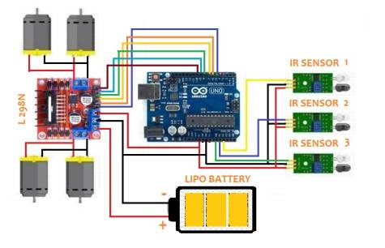
Line follower robot schematic

Slide 13
Results
Realtime frame rate
 | Mobilenet | Efficientnet
Framerate (fps) | 9 | 0.5

Slide 14
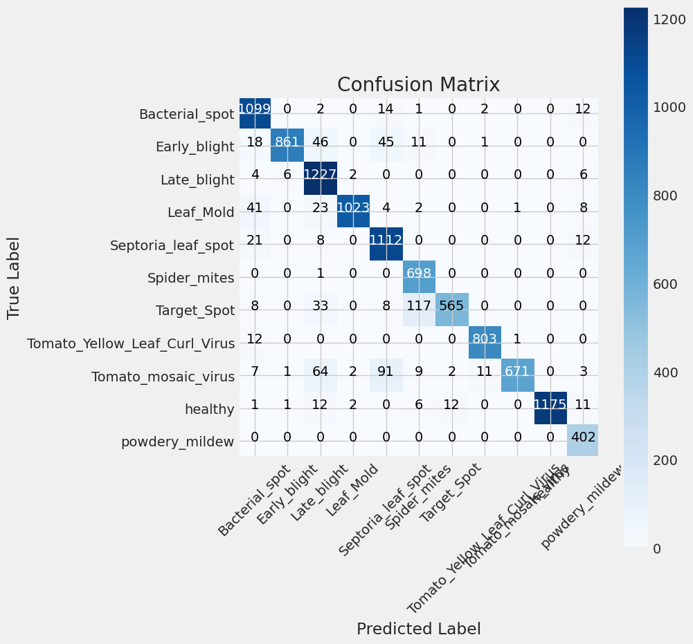
Confusion matrix
Mobilenet

Slide 15
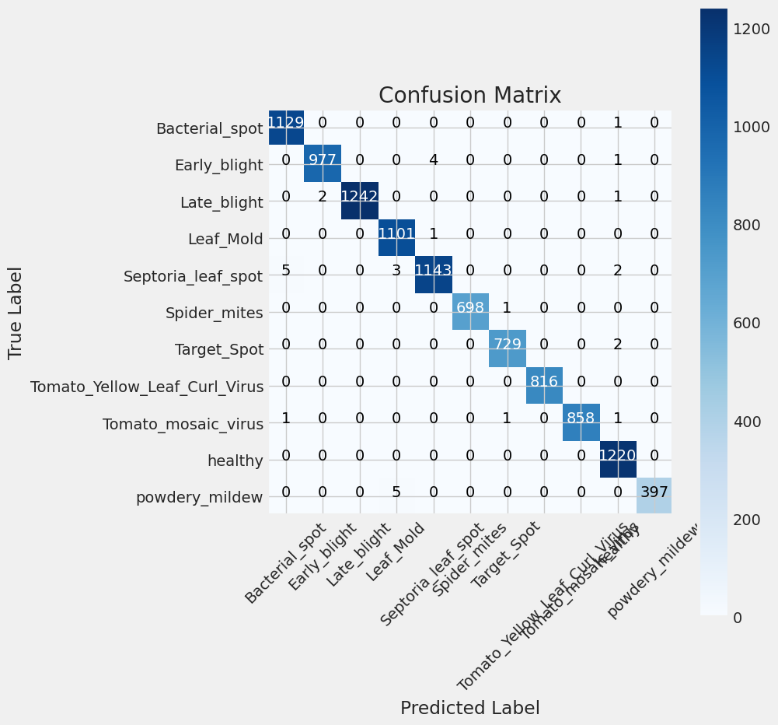
Accuracy
Effecientnet

Slide 16
Mobile net metrics
precision recall f1-score support
Bacterial_spot 0.91 0.97 0.94 1130
Early_blight 0.99 0.88 0.93 982
Late_blight 0.87 0.99 0.92 1245
Leaf_Mold 0.99 0.93 0.96 1102
Septoria_leaf_spot 0.87 0.96 0.92 1153
Spider_mites 0.83 1.00 0.90 699
Target_Spot 0.98 0.77 0.86 731
Yellow_Leaf_Virus 0.98 0.98 0.98 816
Tomato_mosaic_virus 1.00 0.78 0.87 861
healthy 1.00 0.96 0.98 1220
powdery_mildew 0.89 1.00 0.94 402
accuracy 0.93 10341
macro avg 0.94 0.93 0.93 10341
weighted avg 0.94 0.93 0.93 10341

Slide 17
Effeicient net metrics
precision recall f1-score support
Bacterial_spot 0.99 1.00 1.00 1130
Early_blight 1.00 0.99 1.00 982
Late_blight 1.00 1.00 1.00 1245
Leaf_Mold 0.99 1.00 1.00 1102
Septoria_leaf_spot 1.00 0.99 0.99 1153
Spider_mites 1.00 1.00 1.00 699
Target_Spot 1.00 1.00 1.00 731
Tomato_Yellow_Leaf_Curl_Virus 1.00 1.00 1.00 816
Tomato_mosaic_virus 1.00 1.00 1.00 861
healthy 0.99 1.00 1.00 1220
powdery_mildew 1.00 0.99 0.99 402
accuracy 1.00 10341
macro avg 1.00 1.00 1.00 10341
weighted avg 1.00 1.00 1.00 10341

Slide 18
Realtime Valuation frame rate comparison
 | Mobilenet | Efficientnet
Framerate (fps) | 9 | 0.5

Slide 19
Distance accuracies
Distance | 10 cm | 20cm | 30cm | 40
Accuracy | 87% | 85% | 74% | 73%

Slide 20
Algorithm decision and comparison
In conclusion, MobileNet was chosen as the better algorithm for this application due to its increased speed despite its lower accuracy. During testing, it was noted that the Orange Pi frequently overheated when using EfficientNet. This is a potential problem that would need to be addressed if EfficientNet were to be used in the future.

Slide 21
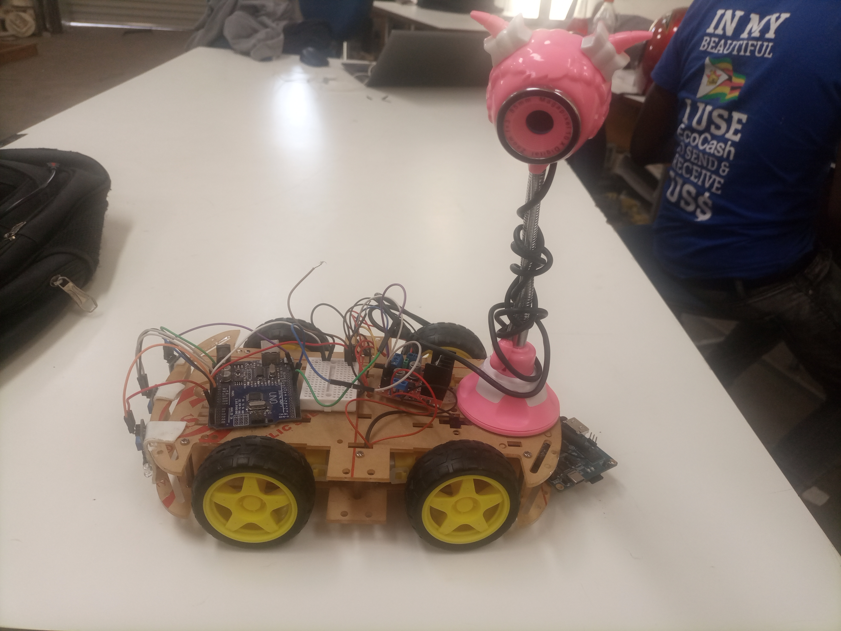
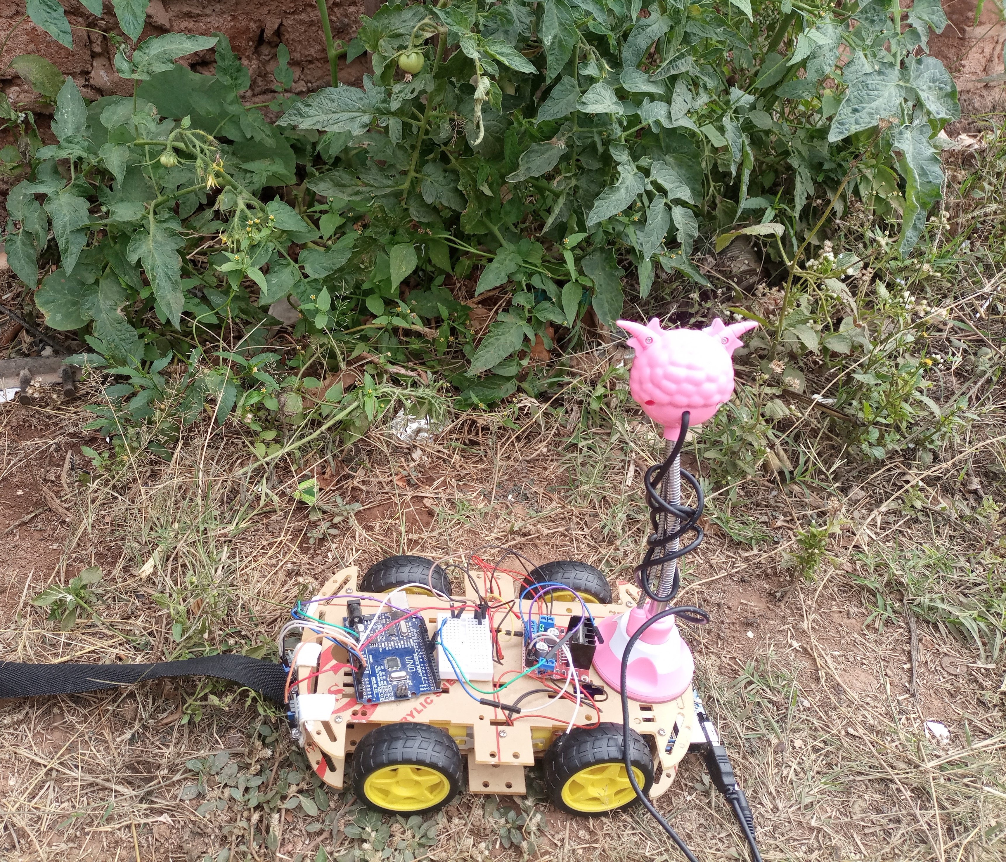
Final Product

Slide 22
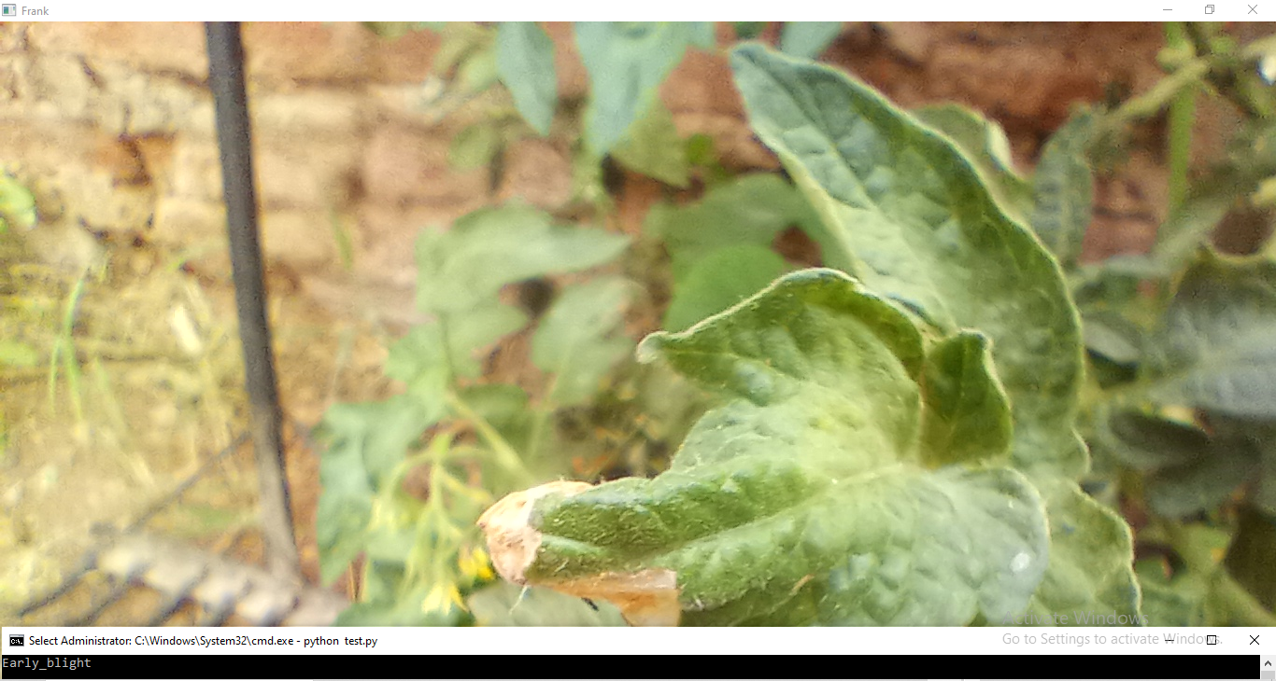
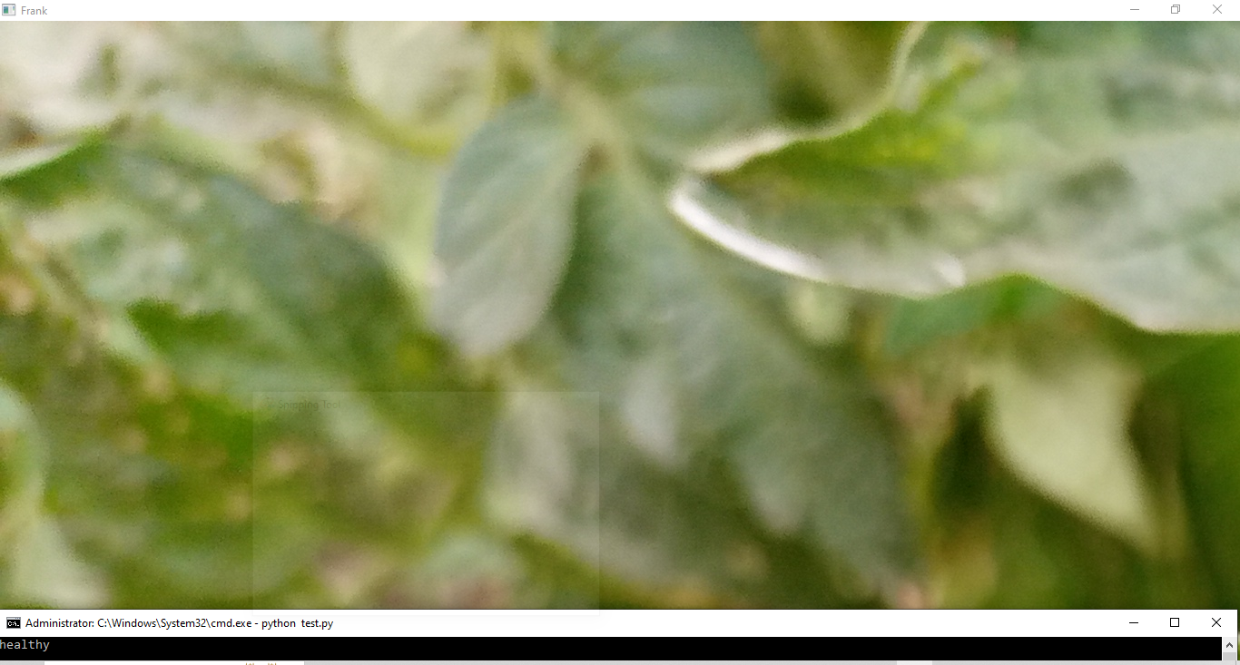
Test In field

Slide 23
FINAL CONCLUSION
The developed robot was able to achieve the desired accuracy and frame rate. It was also able to successfully detect plant diseases in a greenhouse environment. The results of this study suggest that CNNs, computer vision, and computer vision can be used to develop effective plant disease detection robots. These robots have the potential to improve crop yields and reduce the use of pesticides.

